Slide 1
Virtual Clothes Try-on
Team 38:
Jorge Olivares
Robin Martinez
Alan Vela

Slide 2
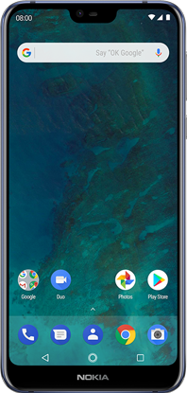
Overview
Neural Network
UI
Application Design
Shape Representation
Convolutional Architecture
Database
Loss Functions and Optimization
Clothing Companies
User with application
Green - Robin Martinez, Blue - Alan Vela, Red - Jorge Olivares, Purple - End Consumer

Slide 3
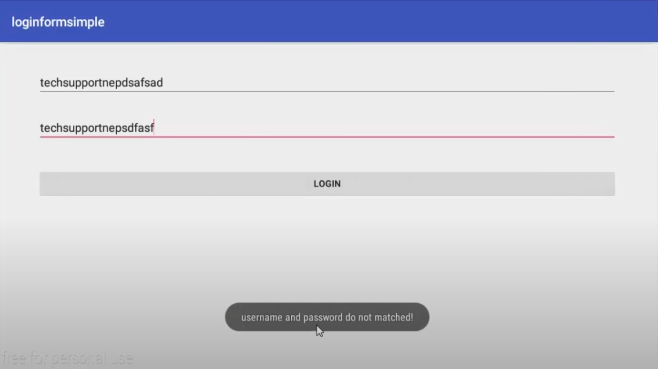
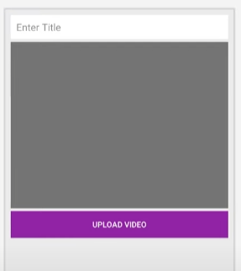
Android Application Subsystem
Accomplishments since the last presentation 12 hrs | Ongoing progress/problems and plans until the next presentation
Learned Android Studio Created Login/Sign In Upload video for avatar | Create shopping theme Create support function Response function for video

Slide 4
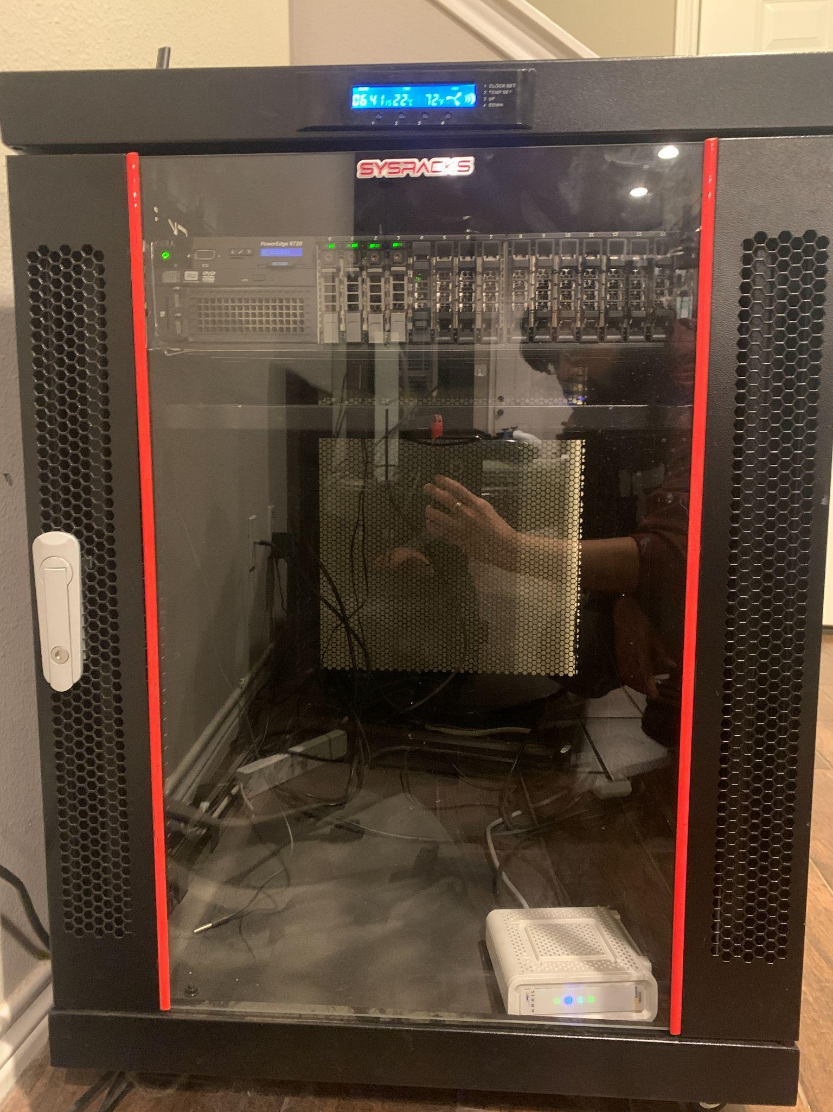
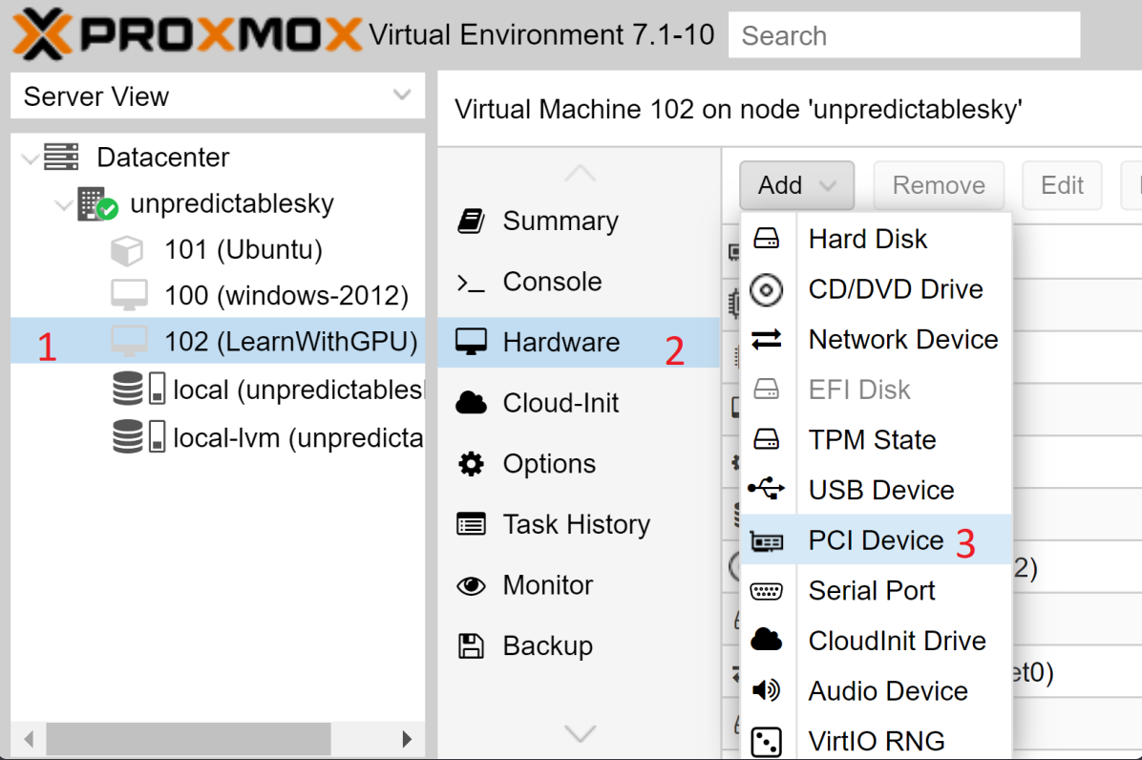
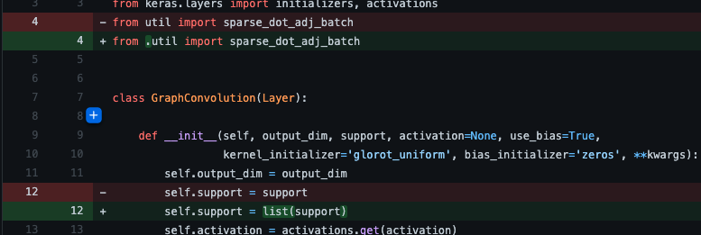
Machine Learning Subsystem
Accomplishments since the last presentation 16 hrs | Ongoing progress/problems and plans until the next presentation
Familiarized with up-to-date paper Partially updated Octopus code and its dependencies to python3 | Keep updating Octopus Code Gain understanding of Tensorflow Setup home server to run Octopus

Slide 5
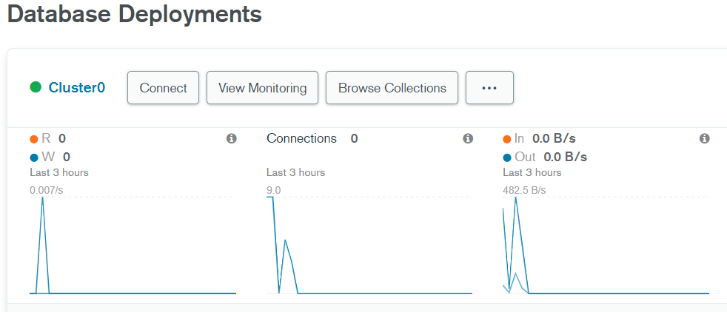
Cloud Database Subsystem
Accomplishments since the last presentation 14 hrs | Ongoing progress/problems and plans until the next presentation
Set up Database Establishing connection to database. Bug fixing | Set up a query system Properly allocate a document in the database

Slide 6
Execution and Validation
 | 1/31/22 | 2/7/22 | 2/14/22 | 2/21/22 | 2/28/22 | 3/7/22 | 3/14/22 | 3/21/22 | 3/28/22 | 4/4/22 | 4/11/22 | 4/18/22 | 4/25/22
Researching Problem |  |  |  |  |  |  |  |  |  | Done
Splitting Subsystems |  |  |  |  |  |  |  |  |  | In Progress
Write ConOps |  |  |  |  |  |  |  |  |  | Behind
Midterm Presentation |  |  |  |  |  |  |  |  |  | Not started
Writing FSR, ICD
Learning Android Studio
Setup database
Updating Octopus Code
Establish connection with database
GUI Theme Created
Setup query system
Status Update Presentation
Populate database
GUI Layout
Train Neural Network
Final Presentation
Final Report

Slide 7
Questions?

